Slide 1
MPEA db figures
Bryce Meredig, Chief Scientist
James Saal, Manager of External Research Programs
Chris Borg, Research Scientist
Tresa Pollock, ALCOA Distinguished Professor
Anton Van der Ven, Professor, Materials
Carolina Frey, graduate student researcher
12 Feb 2020
Robert O. Richie, H. T. & Jessie Chua Distinguished Professor of Engineering
Jon Ell, PhD student
Daniel B. Miracle, Acting Chief Scientist in the Air Force Office of Scientific Research (AFOSR)

Slide 2
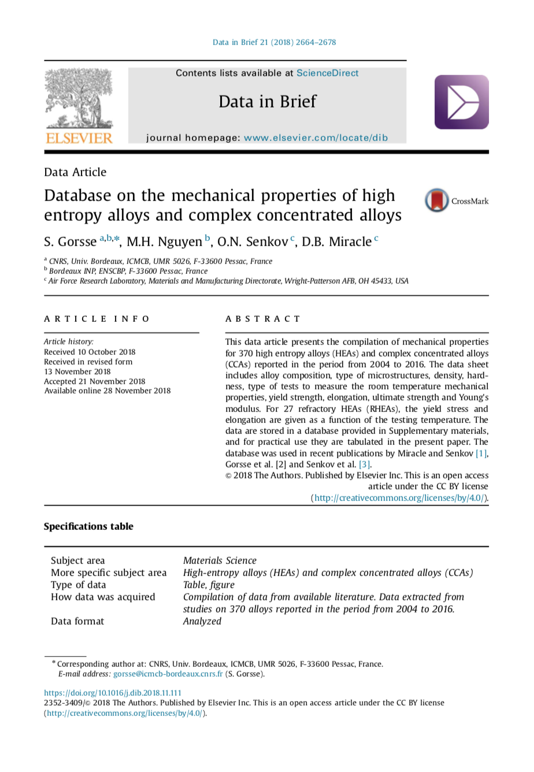
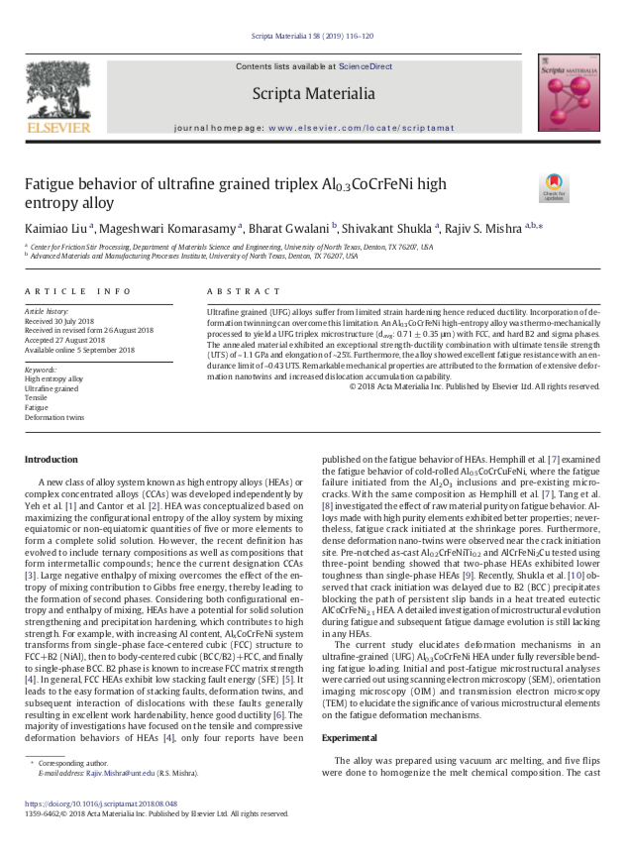
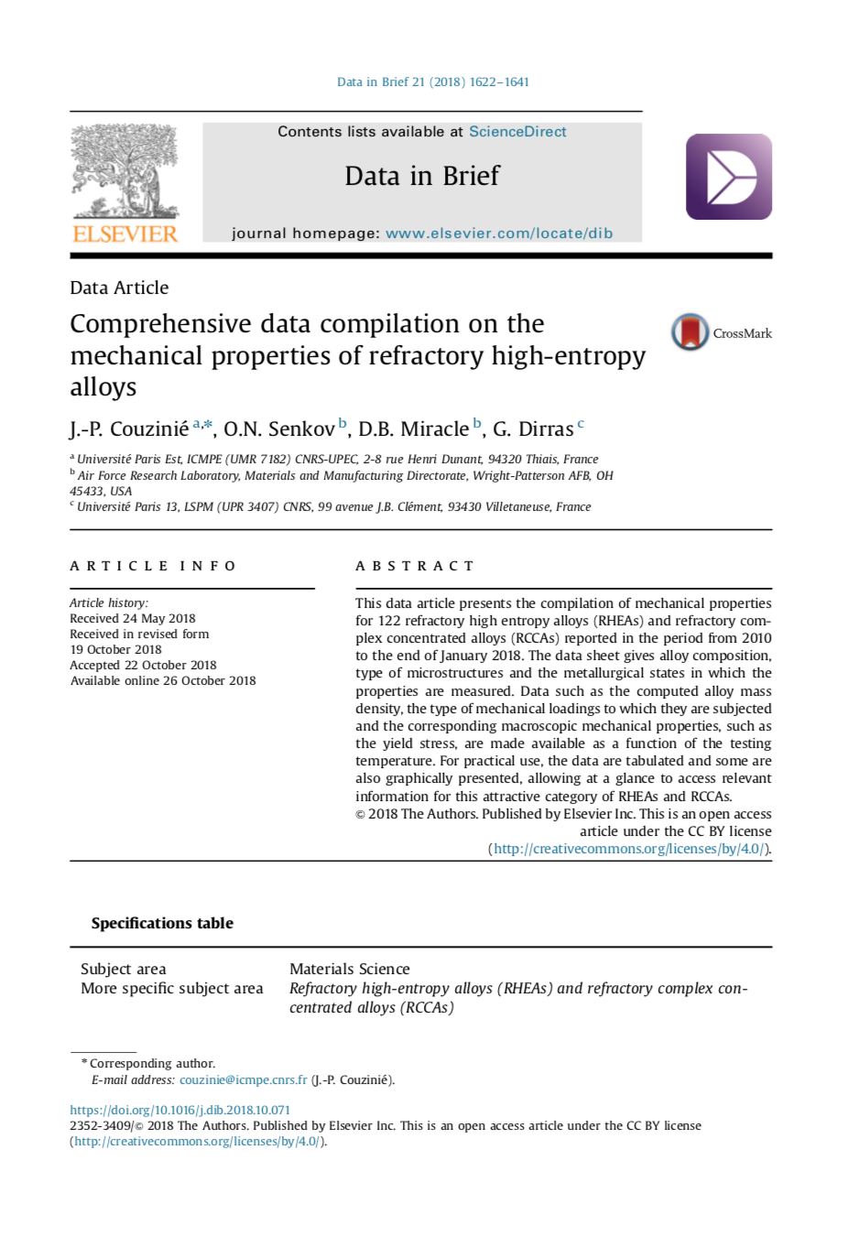
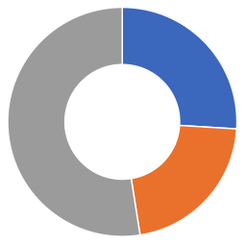
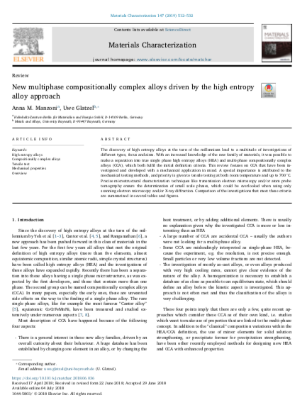
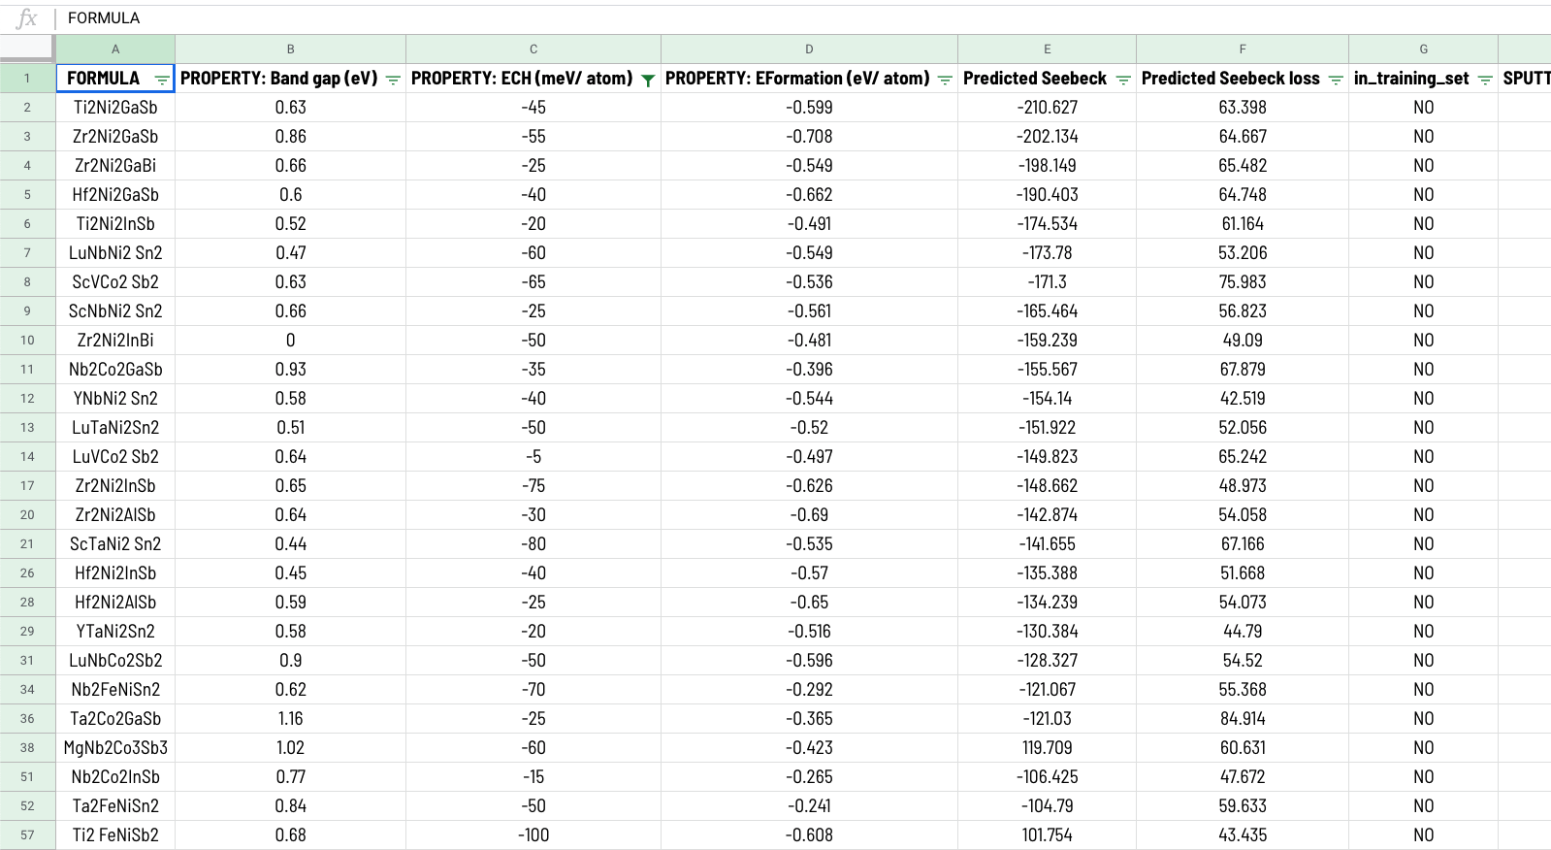
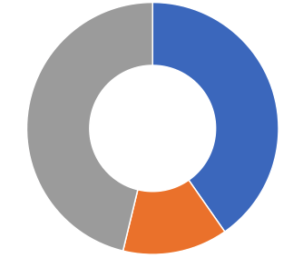
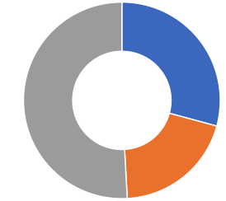
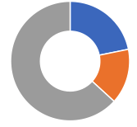
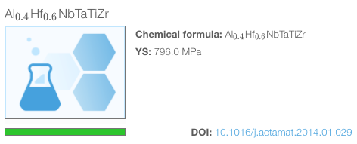
Db workflow
Structured data template
Yield strength
Elongation
other
BCC
671
1112
Ultimate strength
FCC
Hardness
Relevant articles published since 2004. (200+)
547
548
100s of mechanical properties
Web-based data infrastructure
New MPEA publication
Notes:
Add separate sheet

Slide 3
YS scatterplot

Slide 4
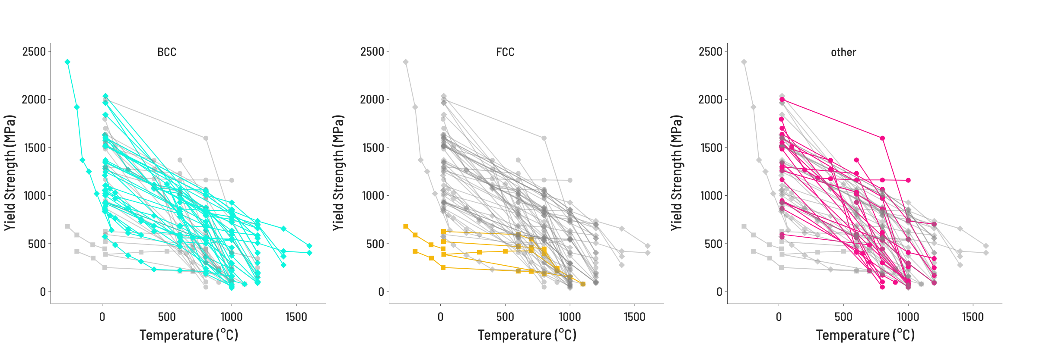
YS temperature
Notes:
Look back at Dan’s papers for inspiration for figures.
”Other”
Subset “X% of the total” = t-dep data

Slide 5
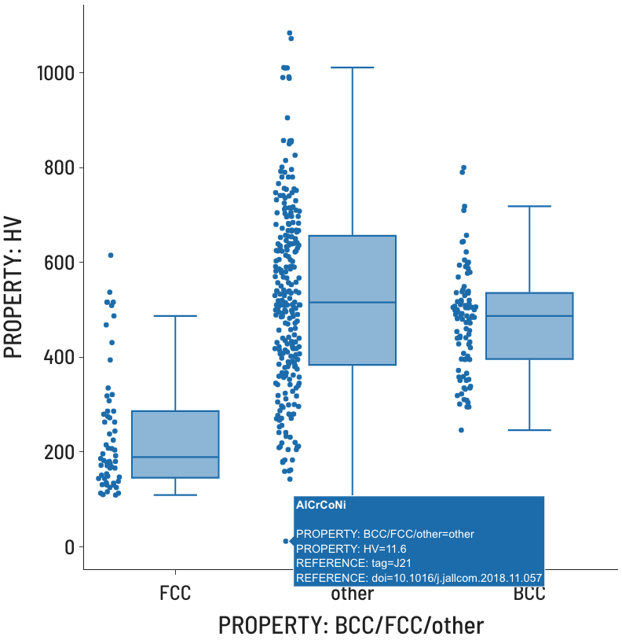
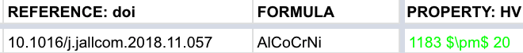
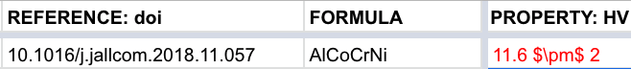
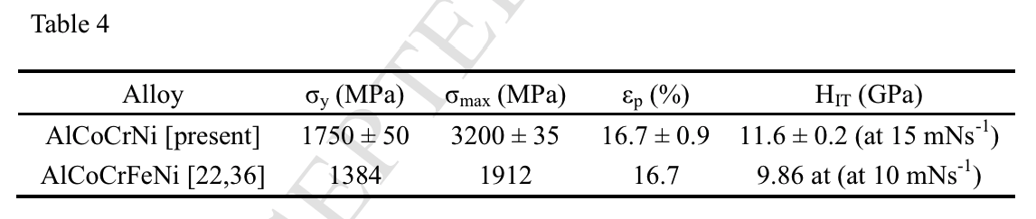
Outlier detection
3
Correct inaccuracy
2
Identify inaccuracy type
Identify source
1
Notes:
Look back at Dan’s papers for inspiration for figures.
Construct frontier and draw that line

Slide 6
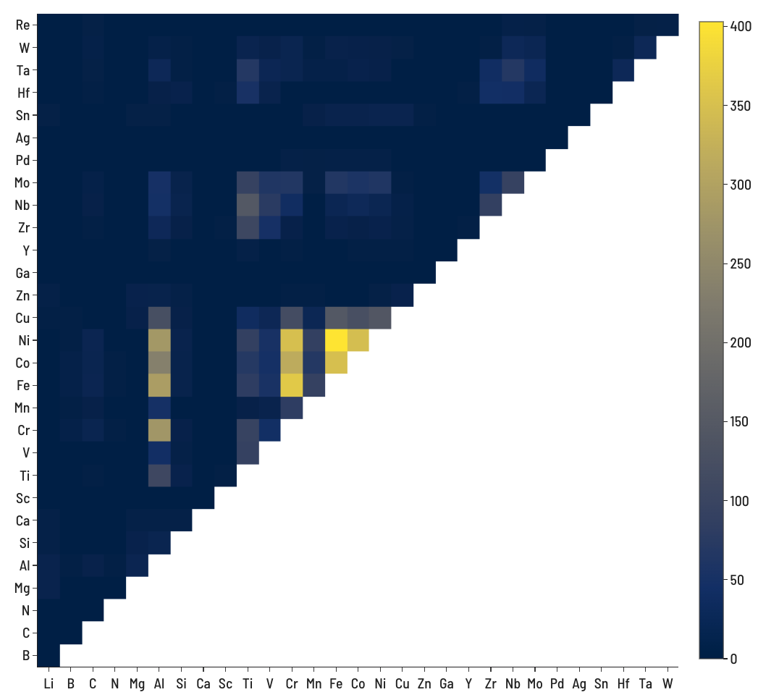
Number of records containing both elements
4-element (ABCD) systems = 27,405
5-element (ABCDE) systems = 142,506
Notes:
Look back at Dan’s papers for inspiration for figures.
Label mat classes, w/ lines
Log scale
Maybe move to seaborn

